Slide 1
String Matching
KMP String Matching
Design and Analysis of Algorithm

Slide 2
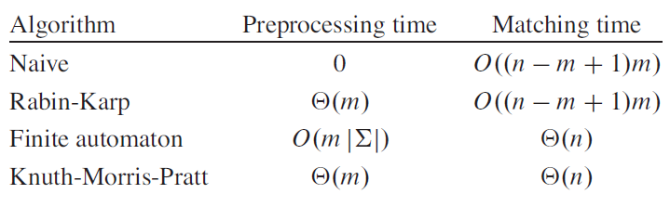

Slide 3
KMP

Slide 4
Knuth-Morris-Pratt Algorithm
Searches for occurrences of a pattern x within a main text string y by employing the simple observation: after a mismatch, the word itself allows us to determine where to begin the next match to bypass re-examination of previously matched characters
Preprocessing phase: O(m) space and time complexity
Searching phase: Ѳ(n) time complexity (independent from the alphabet size)
Runs in linear time.
The algorithm was invented in 1977 by Knuth and Pratt and independently by Morris, but the three published it jointly

Slide 5
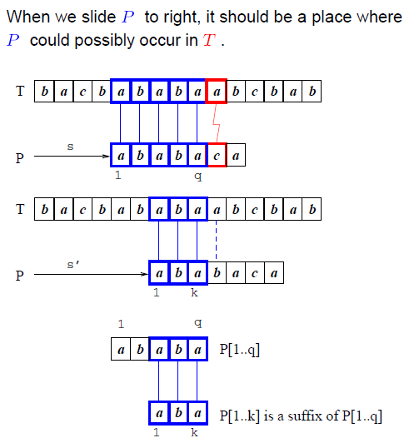

Slide 6
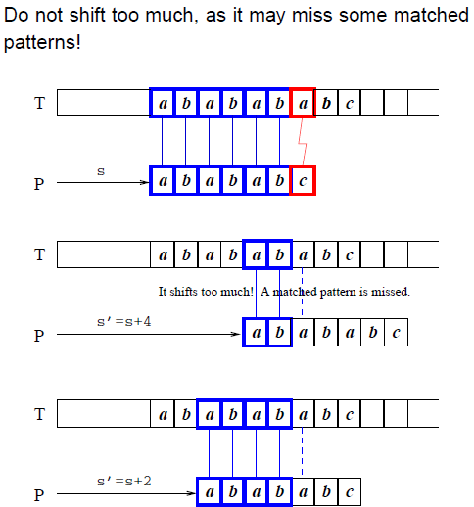

Slide 7
Prefix Function π
The prefix function π for a pattern holds knowledge about how the pattern matches against shifts of itself.
This info. can be used to avoid testing useless shifts that the naïve algorithm does
π contains only m entries, where as δ is a table of m|∑| = md entries

Slide 8
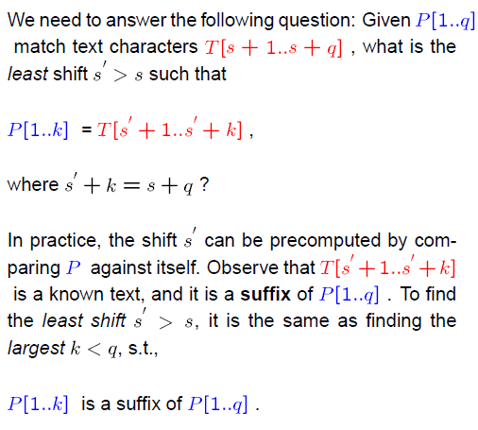

Slide 9
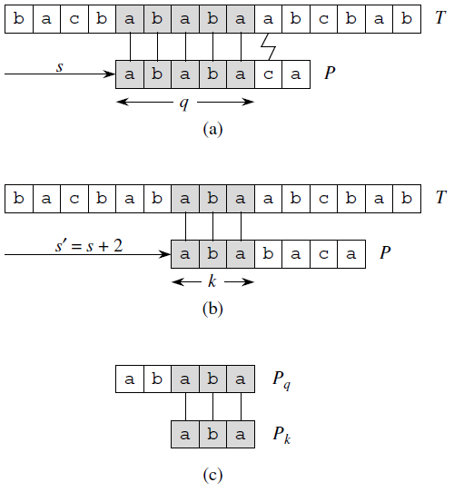
Prefix function
If we precompute prefix function of P (against itself), then whenever a mismatch occurs, the prefix function can determine which shift(s) are invalid and directly ruled out. So move directly to the shift which is potentially valid. However, there is no need to compare these characters again since they are equal.
Fig 32.10

Slide 10
Prefix function
Figure 32.10 The prefix function π. (a) The pattern P = ababaca is aligned with a text T so that the first q = 5 characters match. Matching characters, shown shaded, are connected by vertical lines. (b) Using only our knowledge of the 5 matched characters, we can deduce that a shift of s + 1 is invalid, but that a shift of s = s + 2 is consistent with everything we know about the text and therefore is potentially valid. (c) The useful information for such deductions can be precomputed by comparing the pattern with itself. Here, we see that the longest prefix of P that is also a proper suffix of P5 is P3. This information is precomputed and represented in the array π, so that π[5] = 3. Given that q characters have matched successfully at shift s, the next potentially valid shift is at s = s + (q − π[q]).

Slide 11
Prefix Function π
If P[1..q] = T[s+1..s+q], what is the least shift s’>s such that:
P[1..k] = T[s’+1..s’+k] where s’+k=s+q ?
Such a shift s’ is not necessarily invalid, due to the knowledge of T[s+1..s+q]
In the best case, s’ = s+q, ruling out s+1, s+2 ,…,s+q-1.

Slide 12
Prefix Function π
This info. can be precomputed by comparing the pattern with itself.
Given P[1..m], π : {1,2,…,m} → {0,1,…m-1} such that :
π[q] = max{ k : k<q and P_{k} ╛ P_{q}}

Slide 13
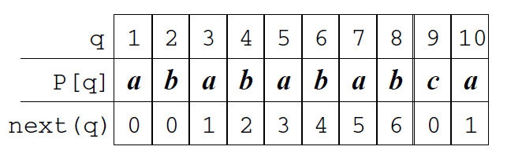
Prefix Function π

Slide 14
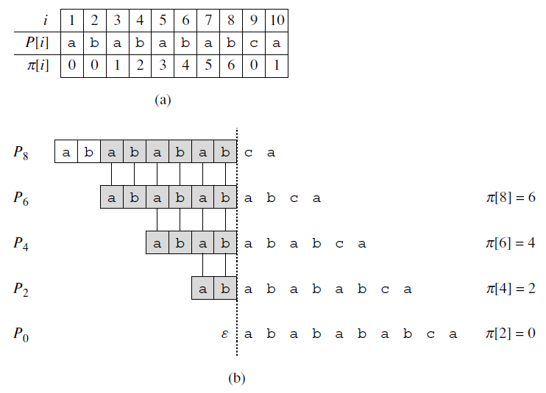
We slide the template containing the pattern P to the right and note when some prefix Pk of P matches up with some proper suffix of P8; this happens for k = 6, 4, 2, and 0
Fig 32.11

Slide 15
Figure 32.11 An illustration of Lemma 32.5 for the pattern P = ababababca and q = 8. (a) The π function for the given pattern. Since π[8] = 6, π[6] = 4, π[4] = 2, and π[2] = 0, by iterating π we obtain π ∗[8] = {6, 4, 2, 0}. (b) We slide the template containing the pattern P to the right and note when some prefix Pk of P matches up with some proper suffix of P8; this happens for k = 6, 4, 2, and 0. In the figure, the first row gives P, and the dotted vertical line is drawn just after P8. Successive rows show all the shifts of P that cause some prefix Pk of P to match some suffix of P8. Successfully matched characters are shown shaded. Vertical lines connect aligned matching characters. Thus, {k : k < q and Pk ❂ Pq } = {6, 4, 2, 0}. The lemma claims that π ∗[q] = {k : k < q and Pk ❂ Pq } for all q.

Slide 16
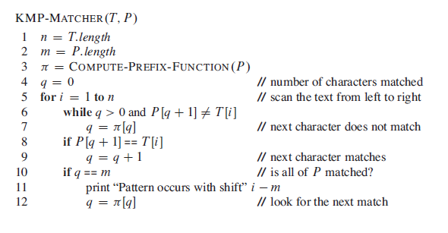

Slide 18
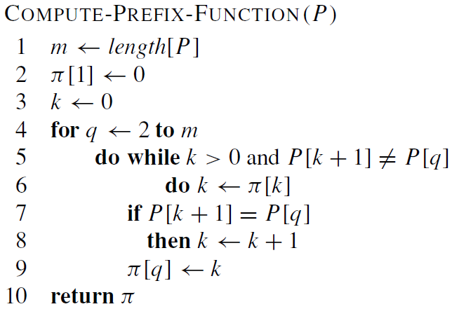

Slide 19
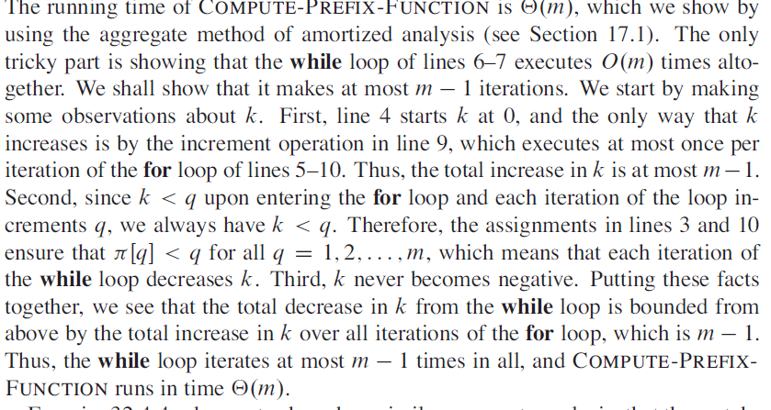

Slide 20


Slide 21
Visualizaers
https://people.ok.ubc.ca/ylucet/DS/KnuthMorrisPratt.html
http://whocouldthat.be/visualizing-string-matching/
http://jovilab.sinaapp.com/visualization/algorithms/strings/kmp

Slide 22
Reference
Introduction to Algorithms
Thomas H. Cormen
Chapter # 32

